Slide 1

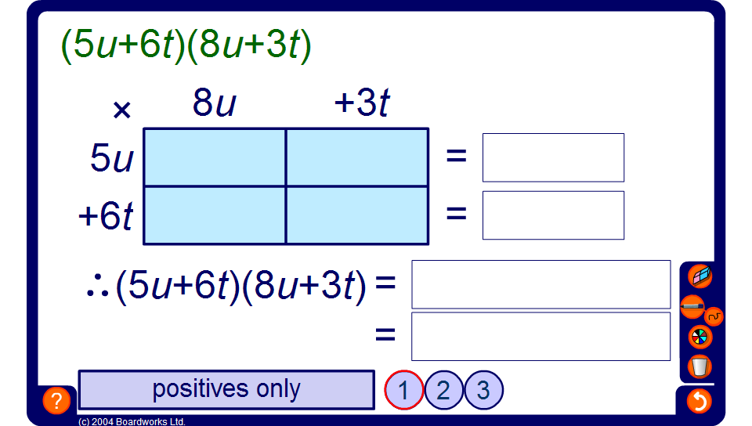


Using the grid method to expand brackets
Notes:
Demonstrate as many examples as is necessary for pupils to understand the method.
Once pupils are happy with the method they may be able to multiply out brackets without using a grid.

